Slide 1
Machine Learning Implementations in Arabic Text Classification
Marwa F. Mohamed

Slide 2
Natural language processing (NLP)
Aims at facilitating communication between
machines (computers that understand machine language or programming language) and
human beings (who communicate and understand natural languages like English, Arabic and Chinese etc.)

Slide 3
NLP applications
Text Classification
Character Recognition
Machine Translation
Speech Recognition
Sentiment Analysis
Question Answering
Spell Checking

Slide 4
Agenda
Classification
Classification Evaluation metrics
Text Classification
Problem Formalization
Text Classification Steps
Data Selection and Preparation
Text Preprocessing

Slide 5
Classification
Is a generic process that assigns a label to an input based on the input characteristics.
A classifier can be as
Simple as classifying a number as being positive or negative, and
Complicated as a physician diagnosing his patient by inspecting his MRI images and ECG signals.

Slide 6
Classification Evaluation metrics
Accuracy
Precision
Recall
F1 −measure
Specificity

Slide 7
Classification Evaluation metrics
True Positives (TP) are those examples classified by the classifier as belonging to the class and they do actually belong to the class.
True Negatives (TN) are those examples classified by the classifier as not belonging to the class and they actually do not.
False Positives (FP) are those examples classified by the classifier as belonging to the class while they are actually not.
False Negatives (FN) are those examples that are incorrectly classified by the classifier as not belonging to the class.

Slide 8
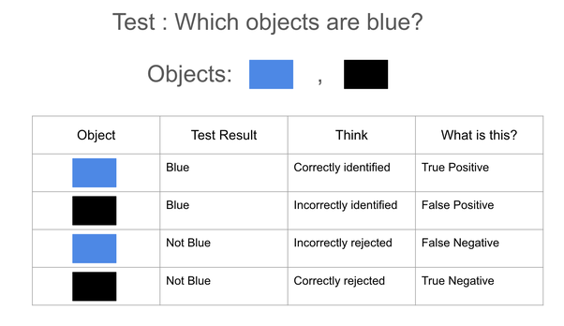
Classification Evaluation metrics
Notes:
True prediction (object Name)
False Prediction (object Name)

Slide 9
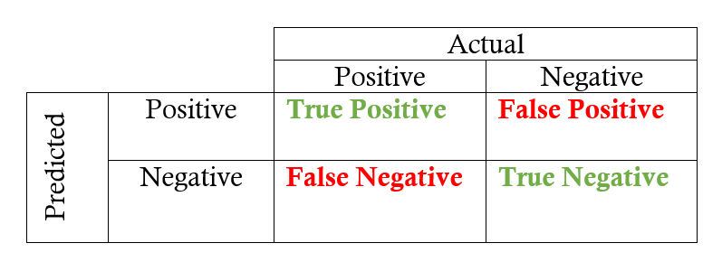
Accuracy
is the proportion of true results among the total number of cases examined.
Accuracy = (TP+TN)/(TP+FP+FN+TN)

Slide 10
Precision
It is the ratio of true positives to the total number of observations predicted as positive i.e out of the observations predicted as positive, what percentage is correct?
Precision = (TP)/(TP+FP)

Slide 11
Sensitivity (Recall or True Positive Rate)
The ratio of true positives to the actual positives in the data. i.e. out of the total actual positives, what percentage have been correctly predicted as positive by the model.
Recall = (TP)/(TP+FN)

Slide 12
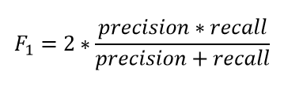
F1 −measure
The F1 score is the harmonic mean of precision and recall.
The highest possible value of an F-score is 1.0, indicating perfect precision and recall, and the lowest possible value is 0 if either the precision or the recall is zero

Slide 13
Specificity
Specificity is defined as the ratio of true negatives to the actual negatives in the data. i.e. out of the total actual negatives, what percentage have been correctly predicted as negative by the model.
Specificity = TN / (TN + FP)
Notes:
Consider a model to predict spam email. So, here spam is our positive class. So, specificity will be
Specificity = Genuine mail predicted not spam / Total number of genuine mail.

Slide 14
Example
Classifying email messages as spam or not spam.
Let's calculate precision and recall based on the following Table
True Positives (TPs): 8 | False Positives (FPs): 2
False Negatives (FNs): 3 | True Negatives (TNs): 17

Slide 15

Precision
Precision measures the percentage of emails flagged as spam that were correctly classified.

Slide 16

Recall
Recall measures the percentage of actual spam emails that were correctly classified.

Slide 17
Text Classification

Slide 18
Text classification
Is the task of automatic sorting of a set of documents or text scripts into categories from a predefined set.
It can be easily concluded from this definition that this task limits itself to text input in contrast with other classification tasks such as image, voice or signal categorization.
The set of possible outcomes of the task of concern is known in advance in terms of its cardinality and even its contained elements.

Slide 19
Text classification
Text classification has a wide range of interpretations depending on the type of text inputs and the labels of output.
The input text ranges in length from long documents (articles, reviews) to short micro-blogging text (Tweets).
The output is usually defined by the purpose of the application and could be binary or multi-valued.

Slide 20
Text Classification Examples
A text classification task with possible outputs from {positive, negative, neutral} assigned to each document/sentence is known as a sentiment analysis problem.
A spam filter, has emails as its input and classifies them into one of two categories {spam, non-spam}.

Slide 21
Text Classification Examples
A text classification task that chooses its output class from a set of authors is called author identification or author detection.
An essay evaluator, assigns a score (say an integer from 1 to 6) to the essay.

Slide 22
Text Classification Examples
Topic/Text categorization typically defines the subject of a given piece of text within a collection of documents.
News stories are typically organized by topics such as politics, sports, and economy.
Academic papers are often classified by technical domains and sub-domains.

Slide 23
What are the different methods to perform text classification?
Manual classification
Hand-crafted rules
Machine Learning Algorithms
Hybrid techniques

Slide 24
Manual classification
We could do the sorting manually like secretaries did in the olden days.
Assign categories to every incoming text.
Then group documents as per common categories.
This method will have the best accuracy, but possible only for small quantities.

Slide 25
Hand-crafted rules for automated classification
A domain expert defines the rules for categorization.
For example:
Text with words "shares, profits, equity, liabilities" is classified into Business category.
Text with words "Messi, kick, Ronaldo, goal" is of Football category.

Slide 26
Machine Learning Algorithms: Supervised techniques chosen based on dataset size and number of categories.
Hybrid techniques:
Start with manual classification and assign categories to a small portion of the training dataset.
Then apply ML algorithms to extend to the rest of the dataset.

Slide 27
Text Classification Steps

Slide 28
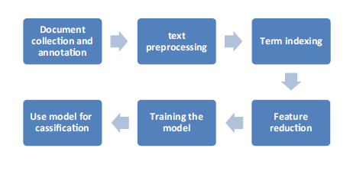
Text Classification Steps
Notes:
Document collection and annotation

Slide 29
Problem Formalization
The first step in any classification problem is to convert your data set into a suitable form that can be processed by the classification algorithm.
In our case, each document represents a single data sample.
The most commonly used document representation is vector space model.

Slide 30
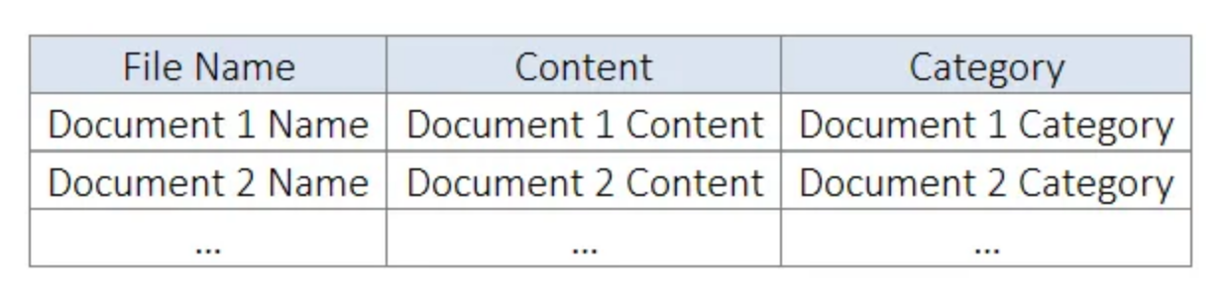
Problem Formalization

Slide 31
Vector Space Model
To sum up, we formalize the text classification problem in vector space model as following:
Set of documents {d₁, d₂, …, d_{j}, …, d_{m-1}, d_{m}},
Set of document labels {c₁, c₂ ,…, c_{k}, …, c_{r-1}, c_{r}},
Set of words {w₁, w₂, …, w_{i}, …, w_{n-1}, w_{n}},
Each document is represented as a vector of word frequencies and paired with a class label to form <v_{j}, c_{j}>

Slide 32
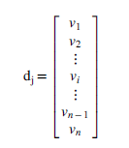
Feature Vector
For each document in the corpus, we construct a feature vector v of n dimensions with each dimension i corresponding to the i^{th} word in the frequency list and n is equal to the number of words in the frequency list.
For each word w_{i} in the words list, we set v_{i} to be equal zero if w_{i} doesn’t exist in the current document, or to a positive value if it does exist.

Slide 33
Bag of Words
A bag of words (BoW) model is a simple way of representing text data as numeric features.
It involves creating a vocabulary of known words in the corpus and then creating a vector for each document that contains counts of how often each word appears.

Slide 34
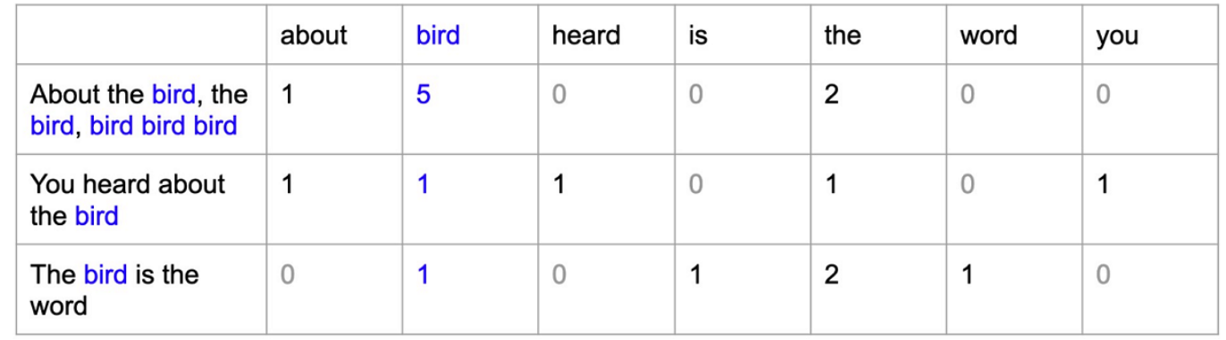
Bag of Words

Slide 35
Problem Formalization
We cannot construct an exhausting vector of all words in the language.
It will be unnecessarily long, hard to collect and hard to process.
Many words that exist in lexicons are rarely or no longer used in real life.
Other modern words are being fabricated from time to time to express emerging concepts.

Slide 36
Problem Formalization
The standard approach to tackling this problem is to use a large collection of documents, typically referred to as ‘the training corpus’, to construct this vector.
All words mentioned in the corpus are used to build a list along with their frequencies.
This frequency list is further compressed by removing rare words whose frequencies are less than a pre-known threshold.

Slide 37
Stop Words
Are functional words in the language that are almost common to all pieces of text.
Do not provide any valuable information about the category of document.
Examples of such stop words are “and- و”, “ he- هو ”, “in- في ” and so on.
We have the frequency list reduced in dimension by removing two types of words: rare words, and very common stop words.

Slide 38
Text Preprocessing
Text Pre-processing is performed to improve the quality of classification task by excluding worthless pieces of information or importing useful ones.
For the topic classification task, excluding useless information is done using stemming and normalization.
Importing useful information is done using n-grams.

Slide 39
Stemming
The two tokens “disease”, “diseases” do not count as two distinct words just because they have different suffixes because they share the same stem.
Returning a word to its original stem by removing suffixes is denoted as “stemming”.
The main advantage of stemming is reducing vector space dimensions, which is the number of words used to represent each document in the vector space model.
This reduction is done by aggregating words that have the same stem in the same vector entry.

Slide 40
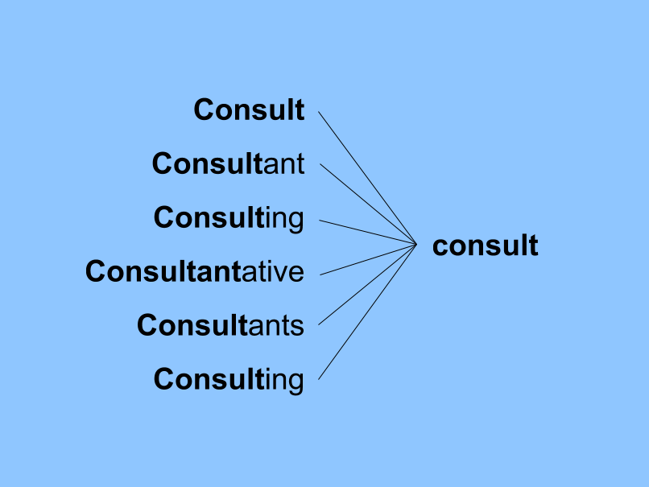
Stemming

Slide 41
Normalization
Is an inevitable step for many text classification problems.
You might find the very same word expressed in various forms with each occurrence contributing to a different entry in the vector model.
For instance, a country like “Germany” can be written by different Arabic users as “ المانيا ” or “ ألمانيا ”.
It would be non-sensical if we separated them into two distinct words just because some users omitted the starting “Hamza” while they both refer to the same entity.

Slide 42
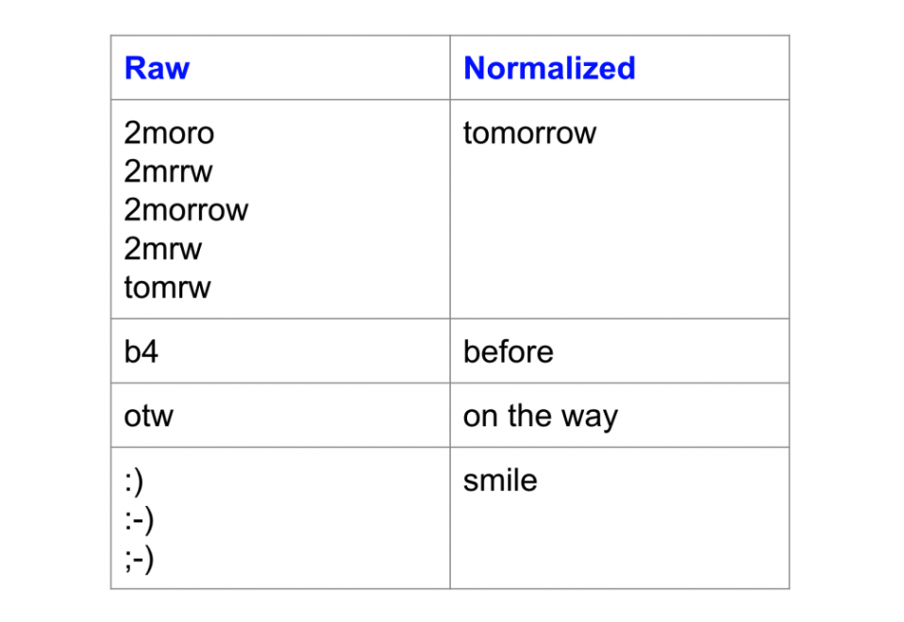
Normalization

Slide 43
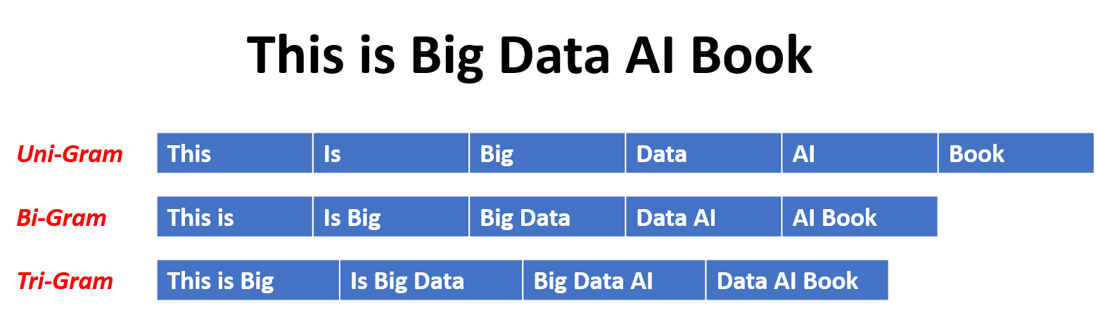
N-grams.
N-gram is simply a sequence of N words.

Slide 44
References
Elarnaoty, M. and Farghaly, A., 2018. Machine learning implementations in arabic text classification. In Intelligent Natural Language Processing: Trends and Applications (pp. 295-324). Springer, Cham.
https://towardsdatascience.com/the-5-classification-evaluation-metrics-you-must-know-aa97784ff226

